Slide 1
EE 150
Intermediate Programming Concepts for Engineers
Lecture Notes on
Unit Testing

Slide 2
Unit Testing
What is it?
Unit testing is an important software development process
Identify separate “units” of source code
Possibly internal (a code block or function)
Or external (according to program specifications)
Each such unit is tested to make sure it is working as specified/designed under various conditions
Across the whole acceptable input range
Handling errors appropriately

Slide 3
Why Unit Testing?
Comprehensive, systematic approach to testing
Improves software reliability and quality
Finds problems early in the development cycle
Tests can be run before the whole program is working, using stubs and drivers
Facilitates changes
Establishing tests in advance allows the same tests to be used after code is modified
quickly and easily verify that the fix was successful
check to see if the change broke some other part of the code
Improves design by making your code testable
forces the programmer to keep testing in mind while writing the code

Slide 4
More about Unit Testing
Tests are written concurrently with application code
not after!
Tests are organized and kept separate from the application code.
How to organize your projects and tests (later)
Each test case is independent from others.
Tests are typically short and simple.
Tests are run separately. They are not part of your application.

Slide 5
Two Approaches to Unit Testing
Structural Testing
Functional Testing

Slide 6
Unit Testing Approaches I
Structural testing is based on the structure of the code.
The test suite must include enough input data sets to make sure that
- all functions have been called;
- both the “true” and “false” branches have been executed in “if” statements;
- every loop has been executed zero, one, and more times;
- all branches of every “switch” statement have been executed.
For every input data set, the expected output must be specified. Then the program is run with all the input data sets, and actual output is compared to the expected output.

Slide 7
Unit Testing Approaches II
Unit-level Functional testing focuses on the problem that the program is supposed to solve. Unit-level functional testing involves verifying that each unit is implemented according to specification.
The tester constructs a test data set (inputs and corresponding expected outputs) which includes ‘typical’ as well as ‘extreme’ input data. In particular, one must include input values that are described as exceptional or erroneous in the problem description.

Slide 8
Functional vs. Structural
Structural testing: test all branches of a program
Functional testing: test according to specifications (including predefined erroneous data ranges)
Imbedded assumptions (weaknesses) in each type of testing?
Other difficulties?

Slide 9
When Changing Code
First write a test of the new code you desire and see the test fail (if applicable).
The "test fail" only applies to functionality changes, not organizational changes.
Whenever applicable, don't skip this step.
Make a simple change to the code and test again. Repeat this step until the new test and all previously developed tests in your test suite succeed.
This ensures that the new code does not break any of the older code.

Slide 10
Organization of Projects
A software project in this class should be managed using a directory that is named in a way that identifies the project.
In each of your project directory
-- README.txt: include at the top your name, and email address
-- doc/ : documentations for your project (optional)
-- src/ : source codes of your project
-- bin/: executable programs resulting from the source code
-- test/ : test suite

Slide 11
Individual Test Subdirectories
Each test should be placed in a separate subdirectory under the test suite.
The directory associated with a given test is called an individual test subdirectory (ITS). All ITSs are placed in the test/ directory
The name of an ITS must begin with "test"
test01, test02, test03, ……
test-A, test-B, test-C, ……
test-1, test-2, test-3, ……

Slide 12
Required Components of an ITS
A README.txt file that provides a brief explanation of what is being tested by the test --- that is, what is distinguishing about this test compared to the other tests in the test suite.
A makeme file that performs all necessary compilation steps (e.g., compilation of driver programs) that are needed for the test.
Note: that this typically does not include compilation of the source code that is under test.
A runme file that runs the test and directs all normal output to standard output and all error output to standard error.
Any input files that are needed for the test
A file called correct-output.txt that contains the standard output text that should result from the test.
A file called expected-errors.txt that contains the standard error text that should result from the test.

Slide 13
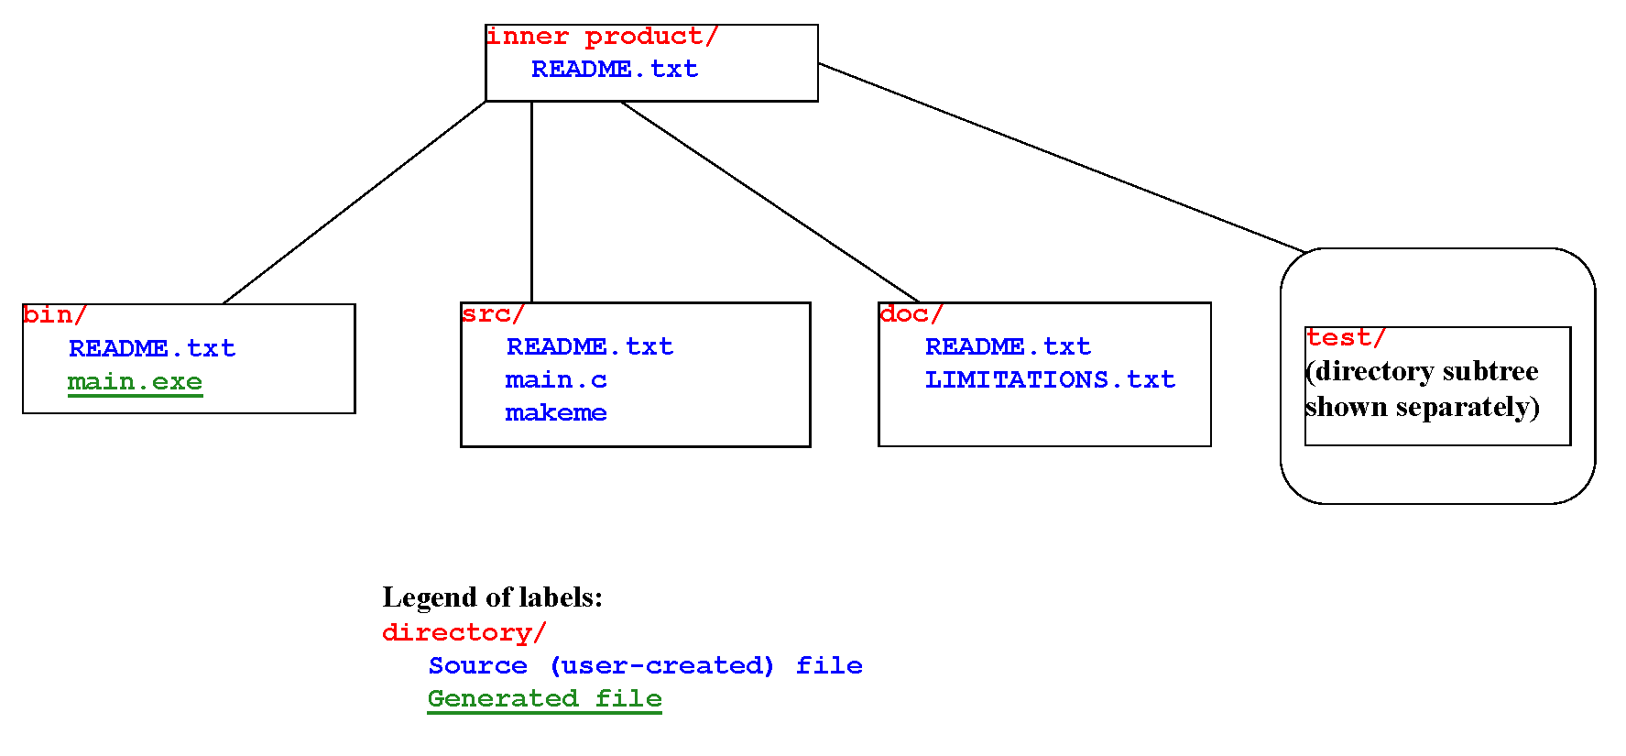
Project Directory Tree

Slide 14
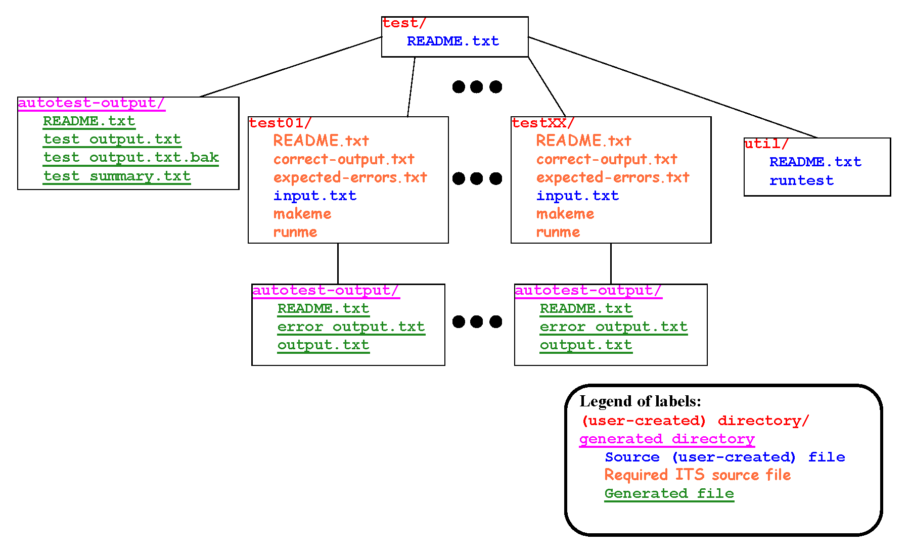
Test Subtree

Slide 15
Why organize your tests this way?
What advantages are there to having a standardized structure?
Standardized test directory structure
Standardized naming convention
Standardized files within each directory
Readme files, makeme files, runme files in each directory
Prepared input.txt files in each directory

Slide 16
DICE utility: dxtest
dxtest is a DICE utility for running all tests in a given test suite
dxtest recursively traverses the directory tree (rooted at the current working directory), and runs all tests
directory names that start with “test” are identified as belonging to the test suite
When used properly, dxtest can save an enormous amount of effort in the test validation process
Usage: dxtest [-v]
The optional –v argument specifies “verbose output”

Slide 17
Setting Up an ITS
To set up an ITS, you can start off by using the DICE dxmktest utility.
Usage: dxmktest <label> <author(s)>
Example: dxmktest 01 “David Kuijt"
… This creates a new ITS called test01
The test label should contain only alphanumeric characters, and possibly also – (dash) or _ (underscore)
The author name should be surrounded by double quotes.
If you already have an ITS for a given source code function, and you want to add another one, an alternative to dxmktest is to make a copy of an existing test directory and make relevant changes for your new test.
Example: cp –r test01 test02

Slide 18
Testing Example: Specifications
Project specification: Implement a program for vector inner product computation that carries out the following steps:
Prompts the user to enter length L for a vector
Reads the vector length L
Prompts the user to enter (from standard input) the elements (integers) of an L-element vector, with successive elements separated by whitespace
Reads the vector
Prompts the user to enter the elements (integers) of another L-element vector
Reads the vector
Computes the inner product of the two vectors and displays the result to standard output
18

Slide 19
Inner Product Example
The inner product project directory, including three ITSs, is provided in the distributed directory called
inner-product-program-example.tar.gz
You are encouraged to
Study all of the files in this directory tree carefully
Build the project (cd to the source directory and run makeme)
Run dxtest in different levels of the test/ subtree and see what happens
Review which of the files in the testing tree are standard/required, and which are artifacts of the specific design of this test suite
Extend the test suite with new tests, and run dxtest

Slide 20
Testing Examples
Test normal conditions
Vector length is more than 1
Vector length is 1 (extreme case)
Detect and handle the following error conditions:
Missing vector length
Invalid (less than 1) vector length
Incomplete first vector
Incomplete second vector

Slide 21
test01
input.txt
3
1 0 2
5 3 -1
correct-output.txt
Enter the vector length:
Enter the first vector, separate each element by whitespace.
Enter the second vector, separate each element by whitespace.
The result is 3

Slide 22
test02
input.txt
1
7
5
correct-output.txt
Enter the vector length:
Enter the first vector, separate each element by whitespace.
Enter the second vector, separate each element by whitespace.
The result is 35

Slide 23
test03
input.txt
-2
1 1
1 1
correct-output.txt
Enter the vector length:
expected-errors.txt
Invalid vector length.

